Slide 1

Atoms and Ions

Slide 2
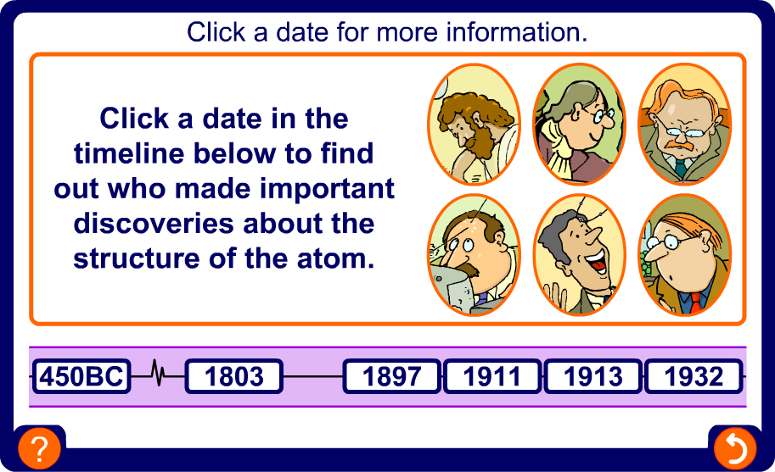
Discovery of atomic structure

Slide 3
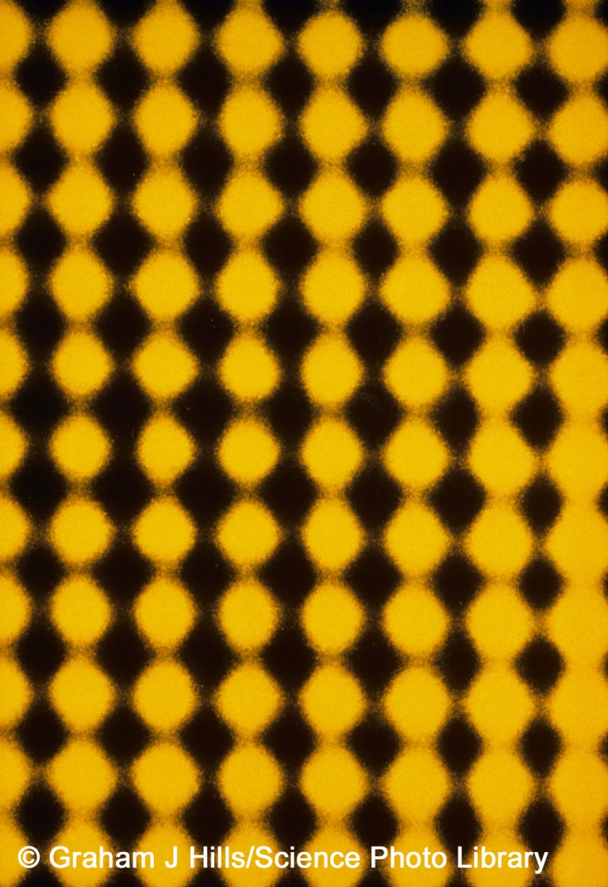
Atoms – the building blocks
All substances are made from very tiny particles called atoms.
John Dalton had ideas about the existence of atoms about 200 years ago but only relatively recently have special microscopes (called electron microscopes) been invented that can ‘see’ atoms.
The yellow blobs in this image are individual gold atoms, as seen through an electron microscope.
Notes:
Acknowledgment
The image is a false-colour high-resolution transmission electron micrograph (HREM) of the atomic lattice of a thin gold crystal. Magnified 16 million times at 35mm size, each yellow blob represents an individual gold atom. The micrograph has been enhanced by optical image- processing techniques. The centre to centre spacing of the atoms is 2.04 angstroms (0. 204 nanometres); this represents the practical limit of resolution of the modern electron microscope.
Credit: Graham J Hills/Science Photo Library

Slide 4
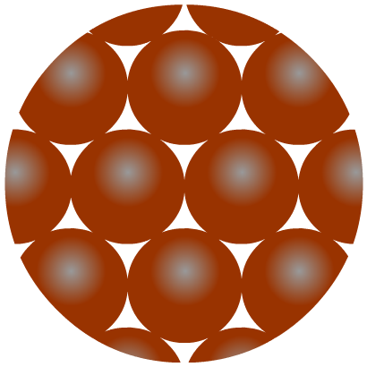
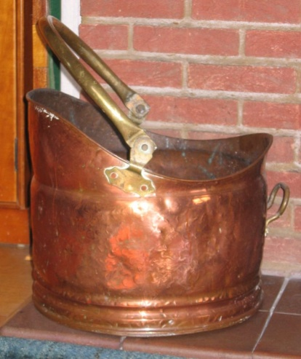
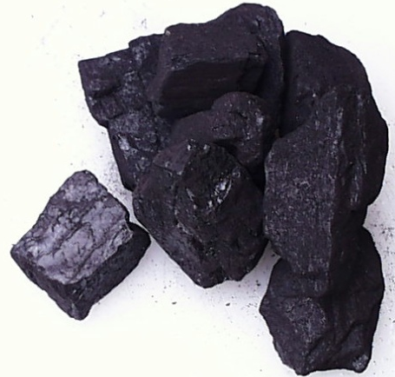
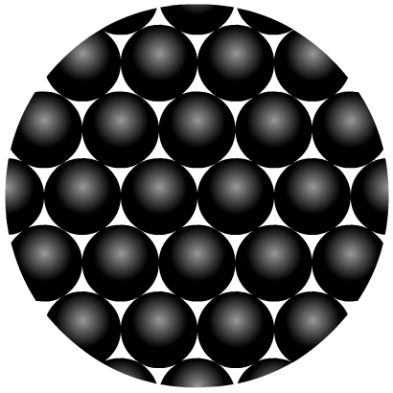
Elements – different types of atom
Elements are the simplest substances.
Each element is made up of just one particular type of atom, which is different to the atoms in any other element.
Elements cannot be chemical taken apart.
Copper is an
element made up of
copper atoms only.
Carbon is an
element made up of
carbon atoms only.

Slide 5

How small is an atom?
Atoms are extremely small – they are about 0.00000001 cm wide.
To make an atom the size of a football it would have to be enlarged by about 3,000,000,000 times.
N
X3,000,000,000

Slide 6
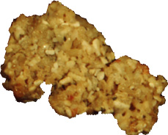
How heavy is an atom?
A single grain of sand contains millions of atoms of silicon and oxygen.
O
millions of these atoms join to form each tiny grain of sand
Si
O
Each atom must therefore have an extremely small mass.
Because atoms are so small that their mass is not measured in grams but in atomic mass units (amu).

Slide 7
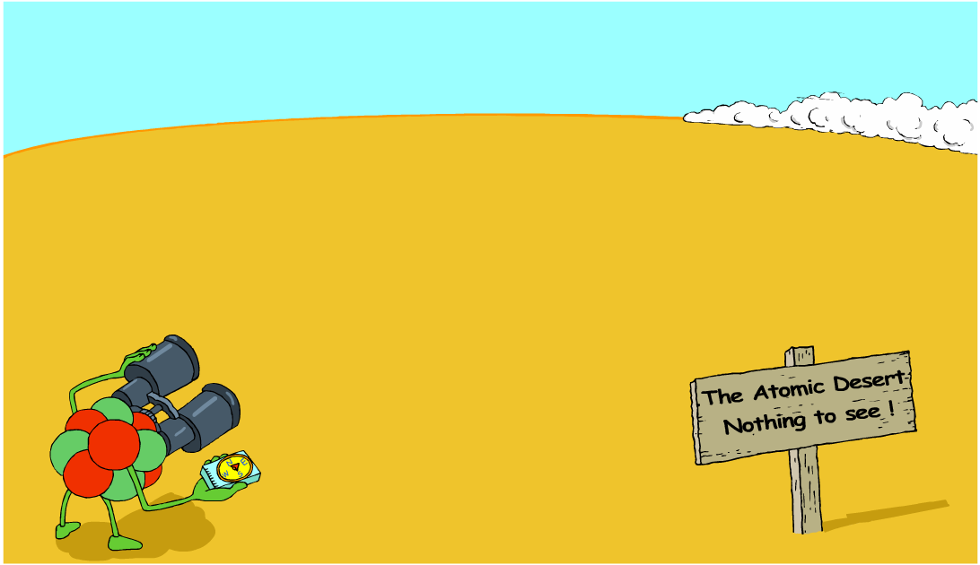
Inside an atom
Where are all the electrons?

Slide 8
Even smaller particles
For some time people thought that atoms were the smallest particles and could not be broken into anything smaller.
Scientists now know that atoms are actually made from even smaller subatomic particles. There are three types:
Proton (p⁺)
Neutron (n⁰)
Electron (e⁻)

Slide 9
Where are subatomic particles found?
Protons, neutrons and electrons are NOT evenly distributed in an atom.
The protons and neutrons exist in a dense core at the centre of the atom. This is called the nucleus.
The electrons are spread out in the space around the nucleus. They orbit the nucleus in layers called shells.

Slide 10
The nucleus is:
Dense – it contains nearly all the mass of the atom in a tiny space.
Made up of protons and neutrons.
Positively charged because of the protons.
Electrons are:
Thinly spread around the outside
of the atom.
Very small and light.
Negatively charged.
Found orbiting the nucleus in layers called shells.
Able to be lost or gained in chemical reactions.

Slide 11
Properties of subatomic particles
There are two properties of subatomic particles that are especially important:
Mass
Electrical charge
Particle | Mass | Charge
proton | 1 amu | +1
neutron | 1 amu | No charge
electron | Negligible | -1
The atoms of an element contain equal numbers of protons and electrons and so have no overall charge.

Slide 12
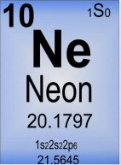
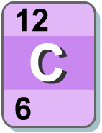
How many protons?
The atoms of any particular element always contain the same number of protons. For example:
hydrogen atoms always contain 1 proton;
carbon atoms always contain 6 protons;
magnesium atoms always contain 12 protons
The number of protons in an atom is known as its atomic number.
It is the smaller of the two numbers shown on the isotopic symbol.
It is also the
on the periodic table.

Slide 13
More about atomic number
Each element has a definite and fixed number of protons. If the number of protons changes, then the atom becomes a different element.
Changes in the number of particles in the nucleus (protons or neutrons) is very rare. It only takes place in nuclear processes such as:
  radioactive decay
  nuclear bombs
  nuclear reactors

Slide 14
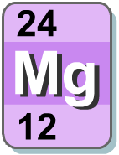
Mass number
Electrons have a mass of almost zero, which means that the mass of each atom results almost entirely from the number of protons and neutrons in the nucleus.
The sum of the protons and neutrons in an atom’s nucleus is the mass number. It is the larger of the two numbers shown in most periodic tables.
Atom | Protons | Neutrons | Mass number
hydrogen | 1 | 0 | 1
lithium | 3 | 4 | 7
aluminium | 13 | 14 | 27

Slide 15
What’s the mass number?
Mass number = number of protons + number of neutrons
Atom | Protons | Neutrons | Mass number
helium | 2 | 2
copper | 29 | 35
cobalt | 27 | 32
iodine | 53 | 74
germanium | 32 | 41
4
64
59
127
73

Slide 16
What’s the mass number?
Mass number = number of protons + number of neutrons
Atom | Protons | Neutrons | Mass number
helium | 2 | 2 | 4
copper | 29 | 35 | 64
cobalt | 27 | 32 | 59
iodine | 53 | 74 | 127
germanium | 32 | 41 | 73
4
64
59
127
73

Slide 17
How many neutrons?
Number of neutrons = mass number - number of protons
Number of neutrons = mass number - atomic number
Atom | Mass number | Atomic number | Number of neutrons
helium | 4 | 2
fluorine | 19 | 9
strontium | 88 | 38
zirconium | 91 | 40
uranium | 238 | 92

Slide 18
How many neutrons?
Number of neutrons = mass number - number of protons
Number of neutrons = mass number - atomic number
Atom | Mass number | Atomic number | Number of neutrons
helium | 4 | 2 | 2
fluorine | 19 | 9 | 10
strontium | 88 | 38 | 50
zirconium | 91 | 40 | 51
uranium | 238 | 92 | 146

Slide 19
How many electrons?
Neutral atoms have no overall electrical charge. This means atoms must have an equal number of protons and electrons.
  The number of electrons is therefore the same as the atomic number.
.
Atom | Protons | Neutrons | Electrons
helium | 2 | 2 | 2
copper | 29 | 35 | 29
iodine | 53 | 74 | 53
Atomic number is defined as the number of protons rather than the number of electrons because atoms can lose or gain electrons but do not normally lose or gain protons.

Slide 20
Calculating the number of electrons
What are the missing numbers?
Atom | Protons | Neutrons | Electrons | Atomic number | Mass number
boron | 5 | 6
potassium | 19 | 20
chromium | 24 | 28
mercury | 80 | 121
argon | 18 | 22

Slide 21
Calculating the number of electrons
What are the missing numbers?
Atom | Protons | Neutrons | Electrons | Atomic number | Mass number
boron | 5 | 6 | 5 | 5 | 11
potassium | 19 | 20 | 19 | 19 | 39
chromium | 24 | 28 | 24 | 24 | 52
mercury | 80 | 121 | 80 | 80 | 201
argon | 18 | 22 | 18 | 18 | 40

Slide 22
Ions
An ion is an atom or a group of atoms that has acquired a net electric charge by gaining or losing one or more electrons.

Slide 23
Ions
cation – ion with a positive charge
If a neutral atom loses one or more electrons
it becomes a cation.
Na
11 protons
11 electrons
11 protons
10 electrons
Na⁺
anion – ion with a negative charge
If a neutral atom gains one or more electrons
it becomes an anion.
Cl
17 protons
17 electrons
17 protons
18 electrons
Cl⁻

Slide 24
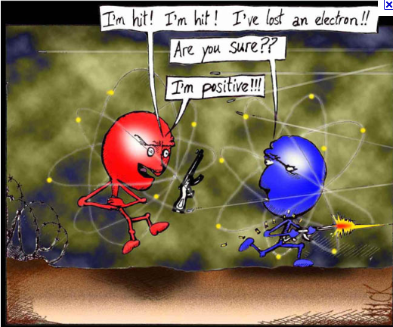

Slide 25
Calculating the number of electrons
What are the missing numbers?
Atom | Protons | Neutrons | Electrons | Overall Charge | Mass number
Sodium |  |  | 10 |  | 24
Manganese |  |  | 23 |  | 55
Aluminium |  |  | 10 |  | 27
Oxygen |  |  | 9 |  | 18
Chlorine |  |  | 18 |  | 35

Slide 26
Calculating the number of electrons
What are the missing numbers?
Atom | Protons | Neutrons | Electrons | Overall Charge | Mass number
Sodium | 11 | 13 | 10 | +1 | 24
Manganese | 25 | 30 | 23 | +2 | 55
Aluminium | 13 | 14 | 10 | +3 | 27
Oxygen | 8 | 10 | 10 | -2 | 18
Chlorine | 17 | 18 | 18 | -1 | 35

Slide 27
A monatomic ion contains only one atom
Na⁺, Cl⁻, Ca²⁺, O²⁻, Al³⁺, N³⁻
A polyatomic ion contains more than one atom
OH⁻, CN⁻, NH₄⁺, NO₃⁻

Slide 28
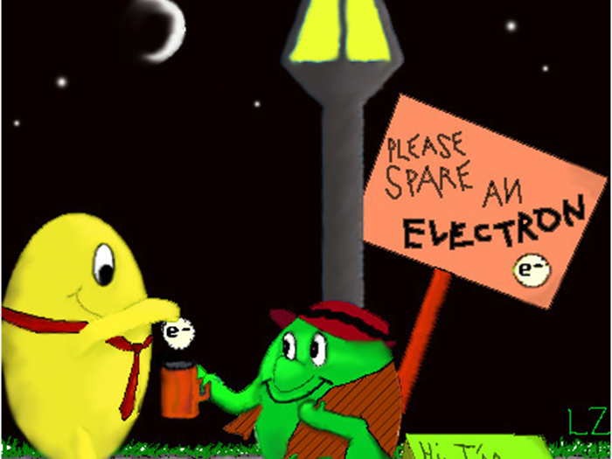
Why are electrons so important?
The movement of electrons are what drives everyday chemical reactions. Because of this we need to learn how electrons are arranged in an atom.

Slide 29
How are electrons arranged?
Electrons are not evenly spread but exist in layers called shells.
The arrangement of electrons in these shells is often called the electron configuration
1st shell
2nd shell
3rd shell

Slide 30
How are electrons arranged?
Bohr proposed that an electron is found only in specific circular paths, or orbits, around the nucleus.
  also called shells
    Each possible electron shell in Bohr’s model has a fixed energy.
      Just like a any thing orbiting the Earth, the electrons must maintain an certain amount of energy to remain in a particular orbit.
      If it loses energy, the electron (or planet) will be pulled toward the nucleus (sun).
      To move away for the nucleus, and electron must gain energy
      This amount energy is referred to as a quantum

Slide 31
How many electrons per shell?
Each shell has a maximum number of electrons that it can hold. Electrons will fill the shells nearest the nucleus first.
1st shell holds
a maximum of
2 electrons
2nd shell holds
a maximum of
8 electrons
3rd shell holds
a maximum of
8 electrons
The electrons in the outermost shell are called valence electrons.

Slide 32
Let’s Practice
Phosphorus Atom

Slide 33
Let’s Practice
P⁻² ion

Slide 34
Let’s Practice
Calcium Atom

Slide 35
Let’s Practice
Ca⁺² ion

Slide 36
There is an easier way
Drawing circles and dots gets tedious.
Easier way- Electron Configuration

Slide 37
Electron Configuration
First thing you need to understand in order to be able to write electron configurations is that each shell is further broken down into subshells
We refer to the shell as an energy level and the subshell as an orbital.

Slide 38
Subshells AKA Orbitals
There are 4 types of orbitals we will learn about.
The shape 3 of the orbital is important to know-How we figured it out is not important for this class
  An orbital is often thought of as a region of space in which there is a high probability of finding an electron.
  Solution to Schrodinger's Equation

Slide 39
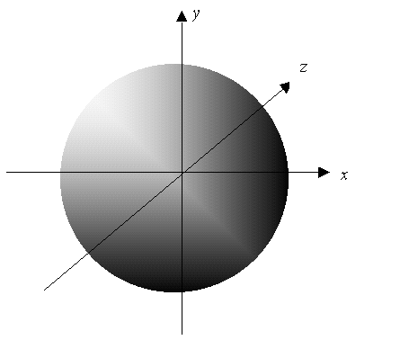
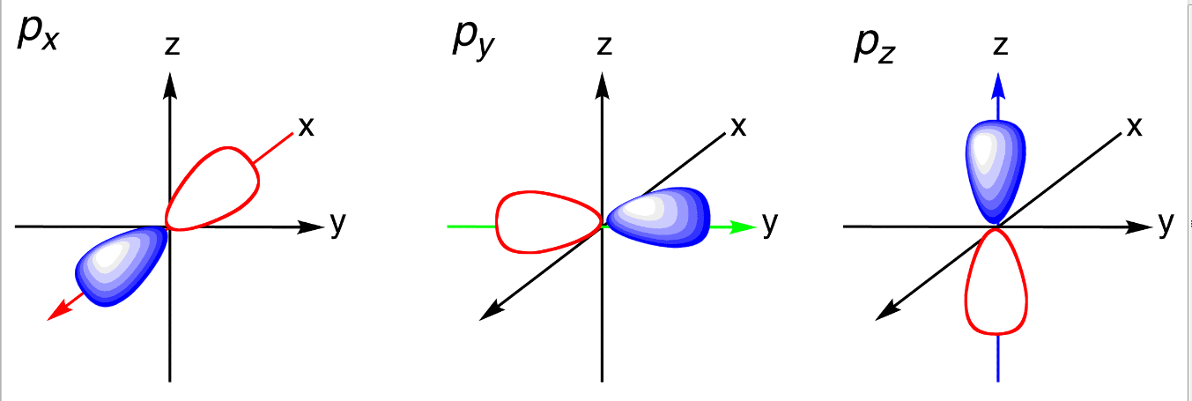
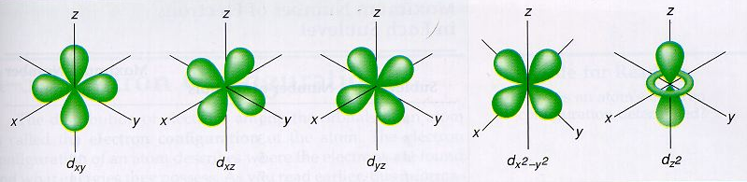

Slide 40
Orbitals
Energy levels are like a rows in a stadium
Orbitals are like the sections
Each section contains a certain number of seats

Slide 41
Orbitals
Row 1 contains section A
Row 2 contains Sections A and B
Row 3 contains sections A,B,C
Row 4 contains sections A,B,C,D

Slide 42
Orbitals
Section A has 2 seats
Section B has 6 seats
Section C has 10 seats
Section D has 14 seats

Slide 43
Orbitals
How many people can be seated in row 1?
How about row 2?
How many total in rows 1 and 2?

