Slide 1
What is an Idiom?
Papa ‘Ekahi
Jan. – Feb. 2014

Slide 2


An Idiom is……..
a word or words used in a way that is different from its usual or dictionary meaning.
  Crack a window if it gets hot in here.
Writers will sometimes use idioms to make their writing sound real.
  Scale the fish.

Slide 3
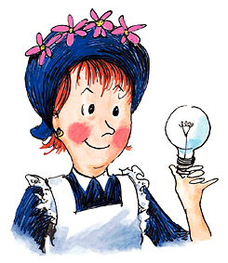



Amelia Bedelia Series
Charming housekeeper
Works for The Rogers Family
Who has a literal-mind
Written by author Peggy Parish
Herman Parish - Nephew of Peggy Parish
Began writing Amelia Bedelia stories in 1988

Slide 4



Amelia Bedelia Books

Slide 5

Book Written in Her Memory

Slide 6

More Idioms
Papa ‘Ekahi
Jan. – Feb. 2014

Slide 7
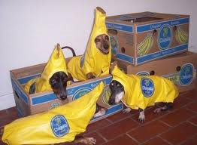

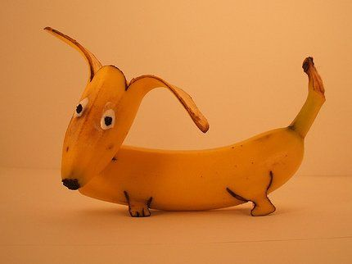

Come quick! Your dog has gone bananas!
What’s the meaning? Your dog is going crazy or having fun.

Slide 8

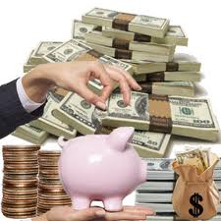
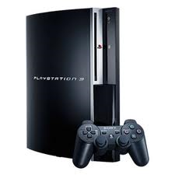
It cost me an arm and a leg to buy this Playstation 3!
What’s the meaning? I spent a lot of money.

Slide 9
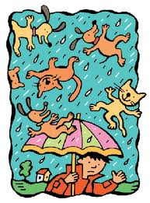
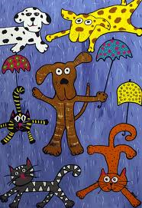

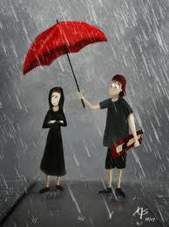
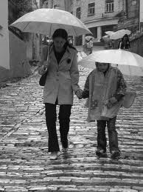
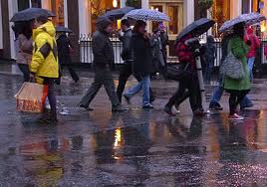
It’s raining cats and dogs!
What’s the meaning? It’s a stormy, rainy, windy day!

Slide 10
Just a bit
More Idioms
Papa ‘Ekahi
February 2014

Slide 11
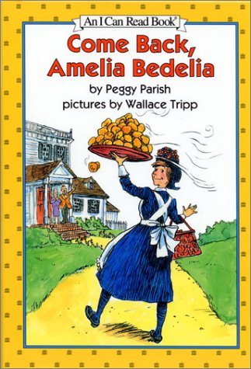
Come Back, Amelia Bedelia

Slide 12
I will have some cereal with my coffee this morning.
Coffee

Slide 13


I would like my hair to be pinned up?

Slide 14
These letters need stamps.

Slide 15

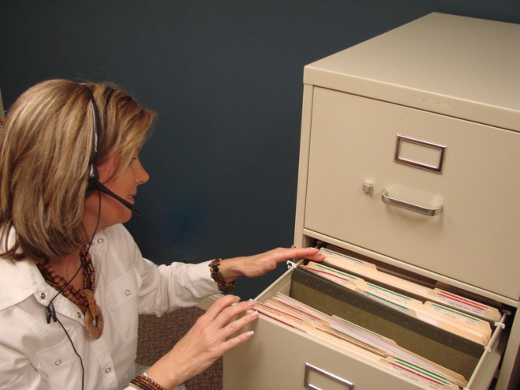
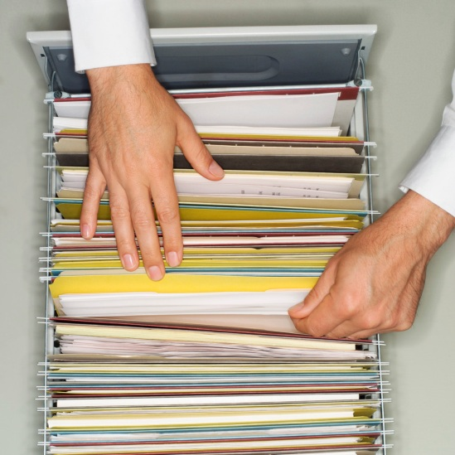
Then file these papers.

Slide 16
Let’s Read!

