Slide 1
Dress Code

Slide 2
What is the Purpose of the Dress Code?
Students’ appearance contributes to character development.
Promote schools’ value of respect for self and student behavioral expectations.
Minimize distractions and assist with focused learning.
Student & Parent Handbook, pg. 24
Notes:
What is the Purpose of the Dress Code?
Students’ appearance contributes to character development.
Promote schools’ value of respect for self and student behavioral expectations.
Minimize distractions and assist with focused learning.
“street clothes” may be distractive and cause financial hardship

Slide 3
Students are required to wear uniforms from the moment they arrive on campus until the end of the school day
Notes:
Students are required to wear uniforms from the moment they arrive on campus until the end of the school day

Slide 4
Daily Uniform
Uniform collared polo
Royal Blue, Sky Blue or White
Uniform long pants, shorts or skits (for girls)
Notes:
The daily school uniform consists of
Collared polo shirt in royal blue, sky blue or white
Uniform long pants, short or skits (for girls only)

Slide 5
Worn Properly
Pants, Shorts or Skirts
Should be worn on the waistline.
Waistbands should not be rolled over.
Skirts should be no shorter than 4” from the floor, when kneeling.
Girls shorts must be Junior Bermuda Navy shorts only.
Notes:
Pants, Shorts or Skirts – must be worn properly
Should be worn on the waistline.
Waistbands should not be rolled over.
Skirts should be no shorter than 4” from the floor, when kneeling.
Girls shorts must be Junior Bermuda Navy shorts only.

Slide 6
Belts
Belts must be worn properly with pants or shorts and visible at all times.
No multicolored belts or belts with designs or advertisement.
Notes:
Belts must be worn properly with pants or shorts and visible at all times.
No multicolored belts or belts with designs or advertisement

Slide 7
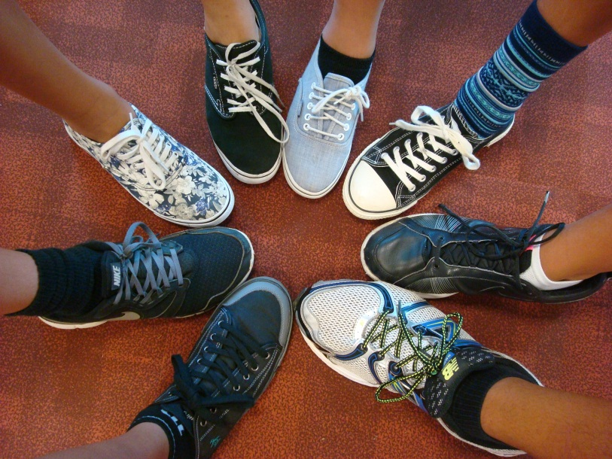
Shoes
Athletic shoes of any color are allowed
Must have shoe laces, no VANS or other shoes without laces are allowed.
Shoes should be clean and worn as the design intends.
Shoe laces must be identical.
Shoes laces must be laced and tied properly.
Notes:
Athletic shoes of any color are allowed
Must have shoe laces, no VANS or other shoes without laces are allowed.
Shoes should be clean and worn as the design intends.
Shoe laces must be identical.
Shoes laces must be laced and tied properly.

Slide 8
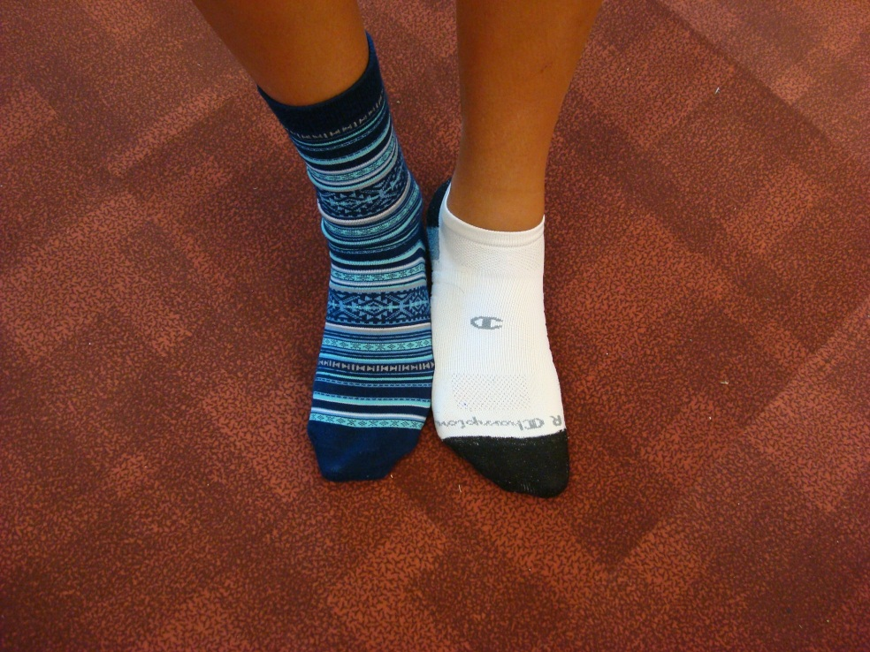
Socks
Identical socks of any color.
Socks are mandatory with appropriate footwear.
Notes:
Identical socks of any color.
Socks are mandatory with appropriate footwear.

Slide 9
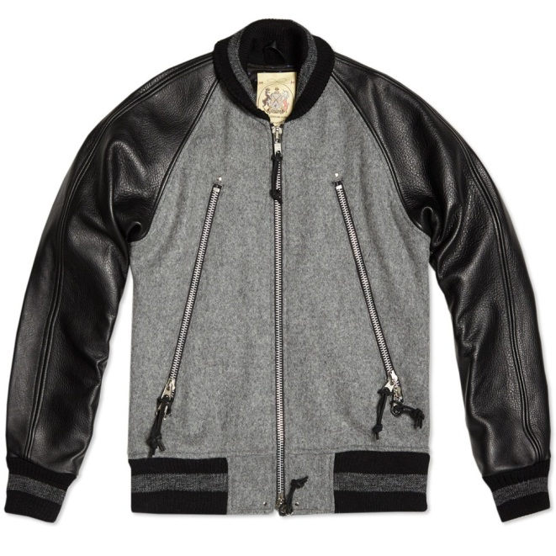
Outerwear
Full (neck to waistband) zipper jacket – any color is permitted.
http://www.endclothing.com/monitaly-raglan-zipper-jacket-m14023gry.html
http://coolspotters.com/clothing/hogan-double-zipper-bomber-jacket
Notes:
Full (neck to waistband) zipper jacket – any color is permitted.

Slide 10
Outerwear
Outerwear sweatshirt/jacket/pullover that is KS-issued (KMS team, KS sports, KS clubs, KS book store) is permitted.
No profanity or inappropriate language or designs are allowed.
Notes:
Outerwear sweatshirt/jacket/pullover that is KS-issued (KMS team, KS sports, KS clubs, KS book store) is permitted.
No profanity or inappropriate language or designs are allowed.

Slide 11
Am I In Dress Code?
View the picture and determine if the individual is in dress code.
If not, identify what is not acceptable.
Notes:
View the picture and determine if the individual is in dress code.
If not, identify what is not acceptable.

Slide 12
Am I in Dress Code?
Notes:
Not in dress code
Slippers
Not tucked in
ID in wrong place
No socks

Slide 13
Am I in Dress Code?
Not in dress code
Slippers
Shirt not tucked in
ID in wrong place
No socks
Notes:
Not in dress code
Slippers
Not tucked in
ID in wrong place
No socks

Slide 14
Am I In Dress Code?
Notes:
NO
ID in wrong place…ID must not cover the school logo and must be worn on the right side.

Slide 15
Am I In Dress Code?
NO
ID in wrong place…ID must not cover the school logo and must be worn on the right side.
Notes:
NO
ID in wrong place…ID must not cover the school logo and must be worn on the right side.

Slide 16
School ID
Students are required to carry KS ID at all times while on campus or at school-sponsored events.
ID must visible and clipped to the right side collar.

Slide 17
Your KS ID is Important
Borrow books at the Learning Center.
Admission to ILH athletic events.
Entrance to School Dances and other school events.
For your Safety.
Lost or Damaged ID?
You may get a replacement ID or plastic pouch from the school office before school begins and during recess. Your school account will be charged.
Notes:
KS ID must be shown
Borrow Books
Admission to ILH athletic events
Your safety
ID cost + 10.00 and Plastic Pouch = 1.00

Slide 18
When Will I Get My ID?
7th Grade Students receive their KS ID in August.
Notes:
On 7th grade picture taking, your school ID will be printed and distributed shortly thereafter.

Slide 19
Am I In Dress Code?
Notes:
NO
Different socks

Slide 20
Am I In Dress Code?
NO
Different socks; socks must match
Notes:
NO
Different socks

Slide 21
Grooming & Appearance
Boys
Only conventional haircuts are allowed and/or in consult with Vice Principal.
Hair should be kept neat. The length of a boy’s hair should not touch the top of the collar of a uniform shirt, should not fall over the eyebrows and should not exceed the bottom of the ear lobe.
Hair should be of its own natural color. Students whose hair cut or hair color is in question will be sent to the Vice Principal’s office for a decision.
The face is to be clean-shaven.
Boys may NOT wear earrings.

Slide 22
Grooming & Appearance
Girls
Hair should be kept neat.
Hair should be of its own natural color.
Students whose hair cuts or hair color are in question will be sent to the Vice Principal for a decision.
Wearing makeup is not permitted.
Wearing nail polish is not permitted.
Girls may only wear stud earrings. Multiple earrings on ear lobes are not allowed.

Slide 23
Body piercing of any kind is not allowed.
Headwear: Hats, beanies, bandanas, visors, sunshades, sunglasses are inappropriate unless authorized for use by the Vice Principal.
Hoods (on jackets) are not to be worn during the school day.
Tattoos or scarring: Any form of permanent body marking is not allowed.

Slide 24
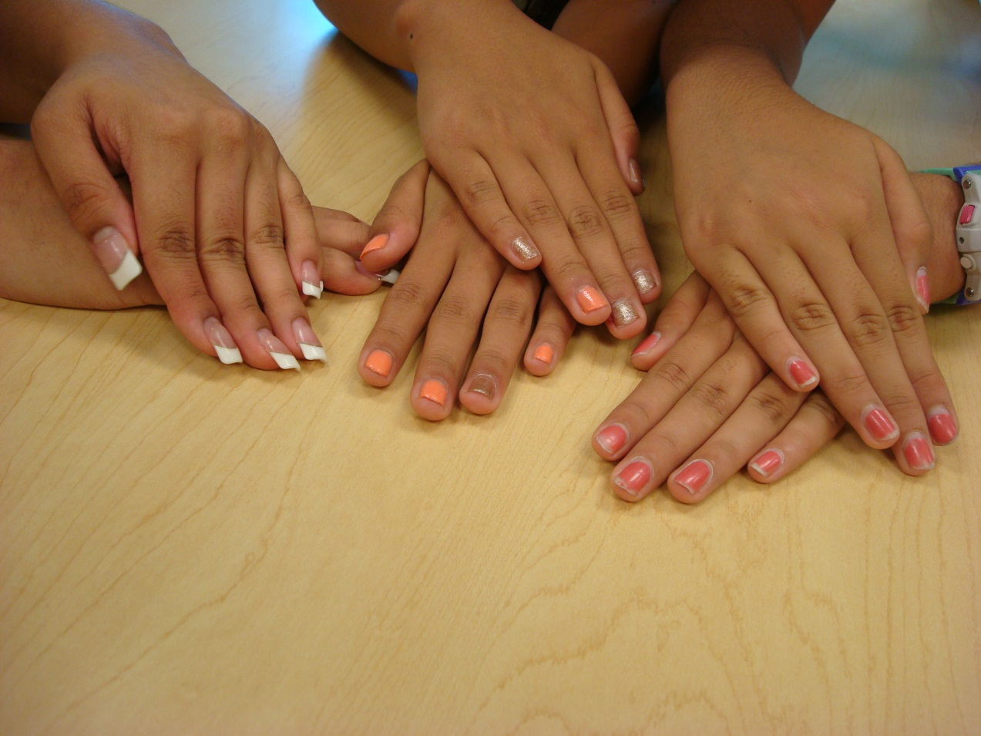
Which of these are acceptable?
Notes:
Answer: NONE!! Nail polish is not permitted.

Slide 25
Which of these are acceptable?
NONE
Nail polish is not permitted.
Notes:
Answer: NONE!! Nail polish is not permitted.

Slide 26
Alternate Dress Days
There are guidelines for the Alternate Dress days in the Student & Parent Handbook, 26 to 27.
Alternate Dress for
Spirit Week will be in
Daily Bulletin.

Slide 27
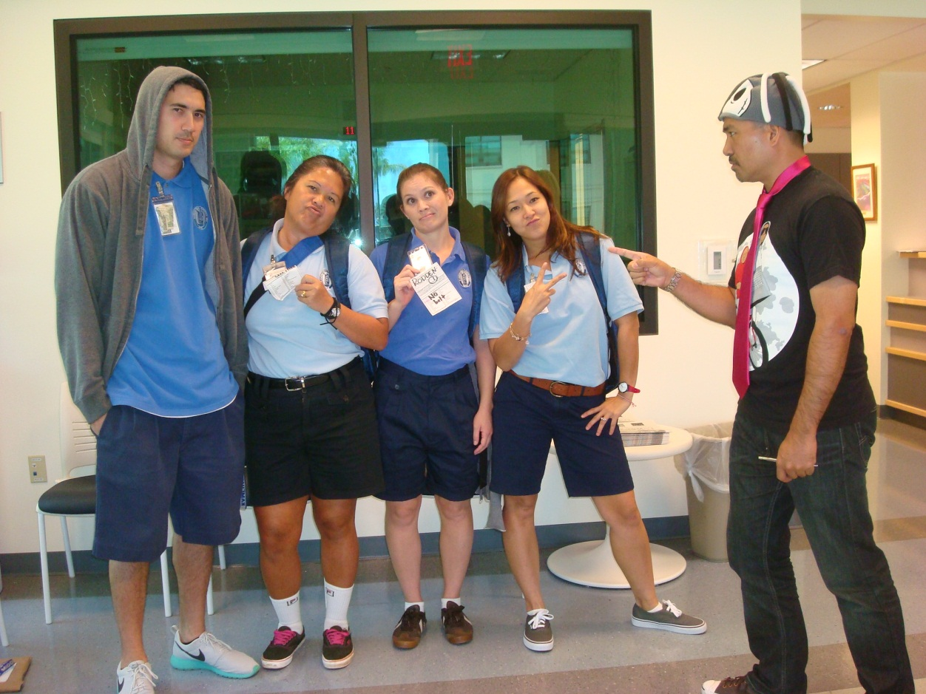
Failure to follow the rules for alternate dress may result in detention.

Slide 28
Alternate Dress: Aloha Friday
Celebrate Aloha Friday as noted on the school calendar.
Wearing aloha attire is an opportunity to “dress up”.
Students have the option of wearing the school uniform.

Slide 29
First Aloha Friday is
on
September 9, 2016

Slide 30
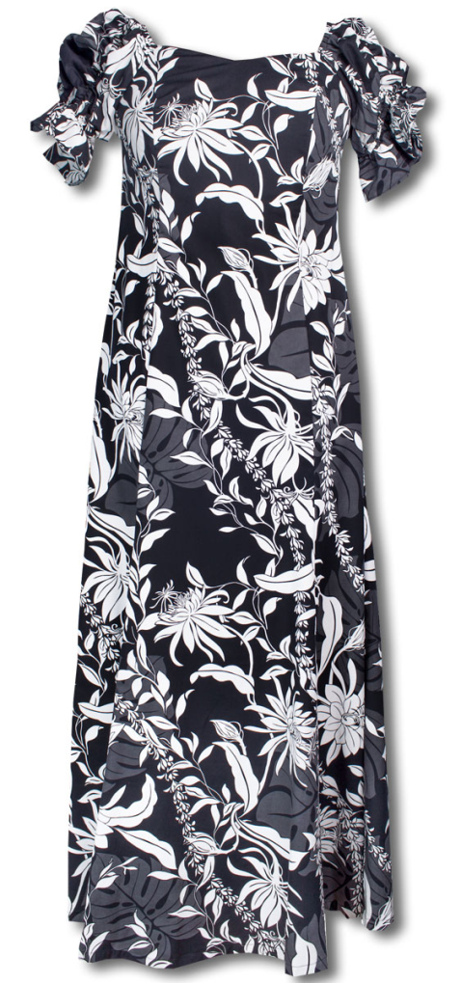
Wahine
Aloha print mu‘umu‘u, dress, skirt or Capri pants.
Dress and skirt lengths should be not shorter than 4” from the floor, when kneeling.
http://www.alohaz.com/collections/hawaiian-traditional-muumuu
http://coolspotters.com/clothing/stella-mccartney-hawaiian-print-skirt

Slide 31
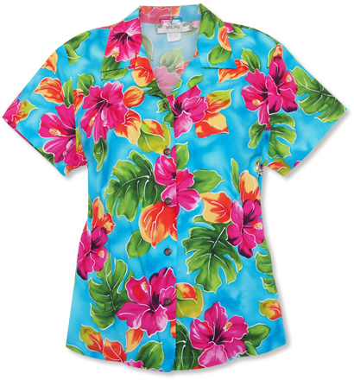
Aloha print top.
Blouses with shoulder straps should have straps that are at least 2 inches in width.
Tops should not show the midriff when arms are raised.
http://www.polyvore.com/stella_mccartney_hawaiian_printed_silk/thing?id=48008663
http://www.lelecloth.com/squish-womens-hawaiian-shirt-aloha-shirt-blue-floral-hibiscus-theme-for-women/
http://www.lavahut.com/hoopla-blue-rayon-hawaiian-blouse-pr-20992.html

Slide 32
Jean pants or skirts. They should be worn at waistline and not be tattered, frayed, or stained.
Sandals or slides may be worn and heels should not be more than 2 inches.
NO: Spaghetti straps (even if worn with outer wear), shorts or slippers
NO: Shorts
Student & Parent Handbook, pg. 26

Slide 33
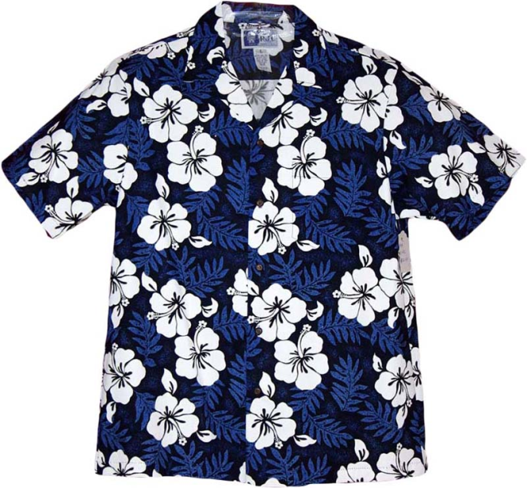
Aloha Friday Attire
Kāne
Aloha print collared shirt (should not be worn as outwear).
Nicely fitted slacks, pants or dress shorts.
Jeans are acceptable but must not be tattered, frayed or dirty.
Shoes or sandals.
NO: Board shorts or slippers
http://hawaiishirtcompany.com/hibiscushawaiianshirt.aspx

Slide 34
PE and Athletic Attire
All students are required to wear uniforms for physical education classes.
P.E. regulation shirts and shorts must be purchased at the Kamehameha Book Store in the ‘Akahi Building.
It is recommended that the uniform be purchased before school begins.

Slide 35
PE Attire and Supplies
2 combination padlocks (no colored face plates) during their swim unit, one for Keawe and one for the pool locker room
At least 3 regulation P.E. shirts
The P.E. uniform, including shoes and socks, are to be worn at all physical education classes.
Mark shirts on the OUTSIDE upper left chest and shorts inside the front waistband.

Slide 36
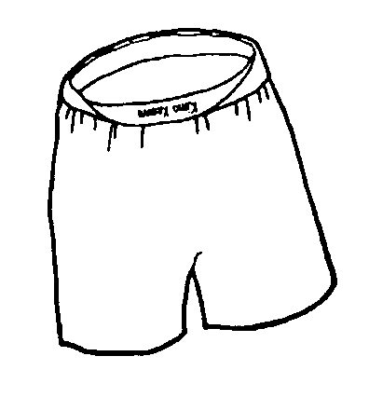
At least 3 pairs of regulation P.E. shorts
1 pair of running or cross training shoes (No black soles because they leave marks on the playing surfaces.)
Mark shirts on the OUTSIDE upper left chest and shorts inside the front waistband.

Slide 37
Shoes and socks should be marked in the inside.
Students must take their uniforms home for laundering at least once a week.
Students are expected to shower after physical education classes and are responsible for their own hygiene products and personal belongings.
Personal items should be locked in their P.E. locker while they are in their classes.
http://download.fromdoctopdf.com/index.jhtml?partner=Y6xdm003&gclid=CKGmq675iMcCFUiFfgodYZQIlQ

Slide 38
Cell phones
Cell phones usage by students is permitted before 7:30 a.m. and after 3:10 p.m. during the school day.
Cell phones may not be turned on or used during the school day and must be securely stored.
The school will not be held responsible for the loss or theft of any cell phone.
A phone used between the hours of 7:30 a.m. to 3:10 p.m. will be confiscated by the faculty/staff member observing the misuse and returned to the student at the end of the school day.
Chronic misuse of a cell phone will be reported to the school office and may lead to disciplinary action (see “Student discipline” section, Level 1) and the cell phone will be confiscated and held for pickup by parents.

Slide 39
Questions?
Review the Student & Parent Handbook

