Slide 1

Academic vocabulary
http://www.uni.edu/becker/la_vocabulary.gif

Slide 2

What is academic vocabulary?
http://www.longbranch.k12.nj.us/cms/lib3/NJ01001766/Centricity/Domain/439/vocabulary%20clip%20art.gif
Notes:
Think, Pair, Share

Slide 3
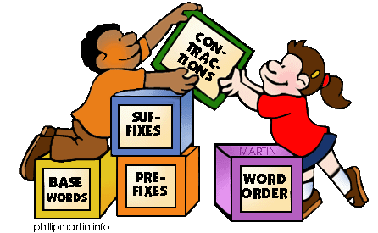
Definition
Words
  used in academic dialogue and text
  not necessarily common
  students would not encounter in everyday conversation
http://clipartzebraz.com//cliparts/grammar-clipart/cliparti1_grammar-clipart_01.jpg
Notes:
COMMON CORE STATE STANDARDS DEFINES AV AS…
Words used in traditional academic dialogue or text
Refers to words not necessarily common or that students would encounter in conversation
Words often relate to other more familiar words students would use, for example watch rather than observe
They are words that help students understand oral directions & classroom instructional dialog.
AV also helps students to understand text across different content areas such as math, science, social studies, English, speech, technology & business etc.

Slide 4

Why is teaching academic vocabulary important?
http://www.hbgoodreaders.com/images/icon_vocabulary.gif
Notes:
Think, Pair, Share

Slide 5
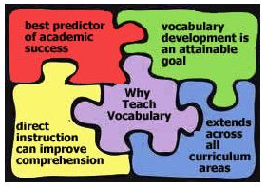
Why is Teaching Academic Vocabulary Important?
Vocabulary linked to comprehension
Importance of understanding
  words
  phrases
  their relationships
  their nuances
  and acquiring new vocabulary
http://www.wappingersschools.org
Notes:
Vocabulary’s link to comprehension has been extensively researched and the importance of directly teaching vocabulary has been firmly established.
Unfortunately, in recent years the teaching of vocabulary has not been frequent or systematic in schools.
Where vocabulary instruction and should focus on “understanding words and phrases, their relationships, and their nuances and on acquiring new vocabulary.”
Research indicates that there is a need to provide direct and explicit instruction for academic vocabulary.
When teaching vocabulary, it is best not to make students look up words in a dictionary or a glossary and write out the definition. They usually pick the first option, and it often isn’t the right one.

Slide 6

Six Steps to Building Academic Vocabulary
By Robert Marzano
Step 1: Teacher provides a description, explanation or example of the new term
Step 2: Students restate an explanation of the new term in their own words
Step 3: Students create a nonlinguistic representation of the term
http://www.translationmanagement.com/wp-content/uploads/shutterstock_132470459-300x300.jpg
Notes:
Here is one suggestion by Robert Marzano a leading researcher in education to building academic vocabulary with your students.
It is a 6 step process
The more times students hear, say it, practice it and use it then it becomes internalized

Slide 7

Six Steps to Building Academic Vocabulary
By Robert Marzano
http://www.leadingchange.net
http://www.leadingchange.net
Step 4: Students periodically do activities that help add to their knowledge of the vocabulary terms
Step 5: Students are periodically asked to discuss terms with one another
Step 6: Students are periodically involved in games that allow them to review terms

Slide 8

Tier 1
Words are basic vocabulary
The more common words most students will know
Include high-frequency words
Usually are not multiple meaning words
tore-and-more.at
Notes:
Vocabulary words are often categorized into 3 tiers
Example: watch, walk

Slide 9
Tier 2
Less familiar, yet useful vocabulary found in written text and shared between the teacher and student in conversation
“general academic words”
“rich vocabulary”
Words are more precise, subtle forms of familiar words & include multiple meaning words
These words are found across a variety of domains/content areas
tore-and-more.at
Notes:
Tier 2
Example: instead of watch, observe
Example: instead of walk, saunter

Slide 10
Tier 3
tore-and-more.at
“domain/content specific”
critical to understanding the concepts of the content taught in schools
Generally, low frequency use and are limited to specific knowledge domains
Examples would include words such as isotope, peninsula, refinery
They are best learned when teaching specific content lessons
Tend to be more common in informational text
Notes:
Tier 3
Think, Pair, Share

Slide 11

Academic Vocabulary
Helps students understand
  words & phrases
  relationship & meaning in context
  nuances
  acquire new vocabulary
  general academic & domain specific words & phrases
http://d118.org

Slide 12

Academic Vocabulary Resources
Marzano’s Six Step Process, Teaching Academic Vocabulary
  http://www.ncresa.org/docs/PLC_Secondary/Six_Step_Process.pdf
Vocabulary list
  http://www.spellingcity.com/high-school-vocabulary.html
http://2.bp.blogspot.com/

Slide 13
Challenge
What are your academic vocabulary for your content area?
http://www.uni.edu/becker/la_vocabulary.gif
Notes:
Create your own list
Work with your team or grade level members
Engage in more research

Slide 14
Mahalo!

