Slide 1
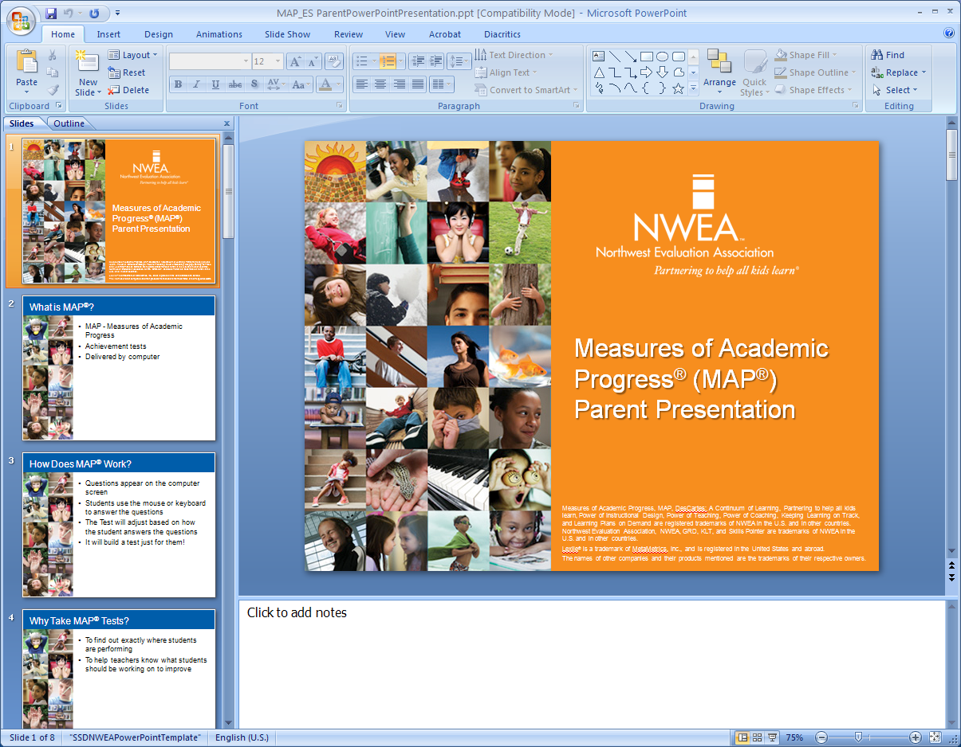
Measures of Academic Progress® (MAP®)
Kapālama High School
Kumu Presentation
February 2015
Notes:
Aloha,
My name is Brandy Ann Sato, your Director of K-12 Curriculum, Instruction, and Assessment at the Kapalama Campus of Kamehameha Schools. I am here to share with you an overview of an assessment that was administered in October 2013 and 2014 to 9th Grade students, the Northwest Evaluation Association Measures of Academic Progress, or MAP.
Today’s brief 5-7-minute presentation is divided into 3 short parts.
(1.) About NWEA MAP
(2.) About Scores
(3.) Student Report
Let’s begin.

Slide 2
Part 1: About NWEA MAP
Notes:
In Part 1, we’ll look closer at MAP.
At KES and KMS, we use MAP as one assessment alongside other classroom based assessments to truly understand student learning and growth. For KES and KHS, It will be administered just in the Fall Semester to provide a “snapshot” of students’ knowledge and skills at a moment in time. KMS administers both in the Fall and in the Spring. Please understand this assessment as one data point among many data points that help us best work with our students throughout the year.

Slide 3

MAP Strengths
Element of MAP | Why it’s helpful
Grade-independent | This allows us to get specific information on what students know, especially those who are above (or below) grade level
Adaptive | When students answer correctly, they receive harder questions; when they answer incorrectly, they receive easier questions
Standards-based | The test ties to a set of performance standards (MAP currently aligns with Common Core state standards)
Growth-focused | Results focus on student learning and provide information on how much a student learns and how that compares to others’ growth in the same subject
Notes:
There are four major strengths to the MAP assessment:
(1.) Grade independent
This allows us to get specific information on what our students knows, especially those who are above or below grade level. This kind of information would be limited by a test that was bound by a proscribed grade level.
(2.) Adaptive
The MAP is a web-based, online assessment. If your student answers a question correctly, a harder question will follow. If your student answers incorrectly, an easier question will follow. Other assessments show how many students are at, above, and below grade level. MAP is able to show how much above, below, and at grade level. A variety of reports and instructional materials are readily available for teachers to supplement how they work with students.
(3.) Aligned to standards, concepts, and skills
The assessment ties to a set of performance standards. MAP currently aligns with Common Core state standards.
(4.) Growth-focused
Results focus on your students’ learning and provide information on how much your students learn and how that compares to other students’ growth in the same subject. We will discuss this further when we discuss scores. Through the learning continuum, scores can tell you what content/skills your students have mastered over time and what they’re ready to learn next.

Slide 4
Part 2: about SCORES
Notes:
Part 2 focuses on understanding the different ways we can understand your students’ knowledge and skills.

Slide 5
MAP = MULTIPLE PERSPECTIVES
GROWTH
NORM-REFERENCED
CRITERION-BASED
“How much did Keala grow between Fall and Fall?”
“How did Keala perform relative to other students who took the test?”
“Did Keala perform well enough to be considered proficient?”
Uses RITs to show how much a student grew from one testing point to another.
Provides growth targets, based on how other students in the same grade level and starting RIT grew.
Aligns to standards and, through Learning Continuum, tells skills and concepts mastered, and what is ready to learn.
Yr 1
Yr 2
- - - Tall
Enough
Bunny
Bunny
Monkey
Notes:
MAP allows us to understand your students’ through different lens. For our tri-campus purposes, we are looking at growth.
Growth
So for example, the question we will ask is” how much did Keala grow between the Fall Semester of one year to the Fall Semester of the next year. We use the measure RITs in order to answer this question. RIT is short for a Rasch unit. The RIT scores relate directly to a curriculum scale in each subject area. It is an equal-interval scale, like feet or inches, so scores can be added together to calculate class or school averages. RIT scores range from 100 to 300. Students typically start at the 180 to 200 level in the grade 3 and progress to the 220 to 260 level by high school. These RIT scores make it possible to follow a student’s growth from year to year.
Norm-Referenced
Growth measures are different than norm-referenced measures that ask, “How did Keala perform relative to other students who took the test?” This provides us growth targets based on how other students in the same grade level and starting RIT grew.
Criterion-referenced
Both growth and norm-referenced are different than criterion-referenced that asks, “Did Keala perform well enough to be considered proficient?” Criterion-referenced measures align to standards. MAP has an instructional resource for teachers called the Learning Continuum that tells what skills and concepts a student has mastered and what a student is ready to learn. Many teachers use criterion-referenced measures through creating standards-based assessments in their classrooms.

Slide 6
WHY GROWTH?
Socioeconomics matter less
Success is defined individually
Every child can grow!
Notes:
Growth is such a key measure for looking at your students’ growth.
(1.) Success is defined individually
Growth means that your students’ progress is assessed relative to his/her previous performance—rather than relative to some external norm group.
The question of which norm group is most like us becomes moot.
(2.) Every child can grow
Not all students will perform at the 90th percentile, but all students can and do grow! Measuring growth allows us to celebrate each student’s individual success. “You may have higher scores, but I grew more than you did!”
(3.) Socioeconomics matter less
Because a students’ success is defined individually (not by other students), growth is less influenced by demographic and socioeconomic factors.

Slide 7
Part 3: Student Report
Notes:
Part 3 introduces you to a sample student progress report available in MAP.

Slide 8
STUDENT PROGRESS REPORT
Shows a student's overall progress by showing a student's term-to-term growth
Notes:
There are numerous reports available in MAP that are useful for administrators, instructors, parents, and students. The Student Progress Report is one of them. This report shows overall progress from all past terms so as your student matriculated through KES to KMS to KHS, you will be able to see growth over time.
It will include growth measures, like the RIT.
The percentile range, or the percentage of students who had a RIT score less than or equal to other students’ scores according to MAP norms study.
The lexile range, that helps you identify reading material that is appropriate in difficulty for your students.
Reports are mailed out to parents following the administration of the assessment.

Slide 9
A Training will be held in the near future for those interested in looking specifically at 9th Grade data. If you have questions, please email me at brsato@ksbe.edu or call me at 842-8059.
Notes:
Mahalo nui loa for your time today to learn more about NWEA MAP.
A Training will be held in the near future for those interested in looking specifically at 9th Grade data. Targeted to teachers of 9th Grade Students and Counselors who service 9th Grade Students. However, I do welcome others who would like to come to deepen their knowledge of this assessment and its results.
More information on this is forthcoming.
Today, I shared with you:
(1.) About NWEA MAP
(2.) About Scores
(3.) Student Report
Please do not hesitate to call me or email me.
Have a wonderful rest of the school year.

