Slide 1
New Year’s Dance
Friday, January 8
Glam vs Grunge

Slide 2
What to Wear
Choose if you would like to dress up or dress casual. Wear what you would to attend a party (dress, sandals, collared shirt, dress pants, etc.) Or use the clothes that you would wear to lounge at home (t-shirt, shorts, slippers etc.)

Slide 3
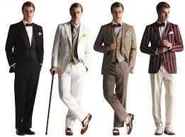
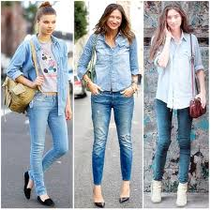
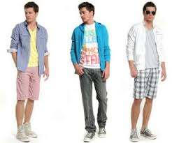
Glam
(Dress Up)
vs.
Grundge
(Dress Casual)

Slide 4
General Dress Code
No tasteless or revealing clothing
No midriffs showing
No low-cut tops/dresses
Girls: All skorts/skirts/shorts must be fingertip length or below
All sandals must have a back strap and heel less than 2 inches
Boys: Earrings NOT allowed
Hats and sunglasses are allowed but must be removed while indoors.

Slide 5
Answers to Frequently Asked Questions
No make-up
Nail polish is allowed but must come off when you return to school on Monday
Slippers are allowed
If you choose not to dress-up you must wear your school uniform

Slide 6
Things to Remember
Your advisory will receive ʻApu Lanakila points for dressing up in dance attire, so please participate!
Students not in compliance with dress code will receive detention

Slide 7
Happy New Year!

