Slide 1






























WHAT’S
NEXT???

Slide 2
MAKING THE FINAL COLLEGE CHOICE
Congratulations!!! We hope that the following hints and recommendations will ease the decision making process for you during the next WEEK OR TWO.

Slide 3
IF YOU HAVE BEEN ACCEPTED TO MORE THAN ONE COLLEGE…
You have to decide which ONE to attend
Compare the colleges to find out which one is the best fit for you i.e. location, size, academics, diversity, extracurricular activities, facilities
Compare financial aid packages
If you are unsure:
  Talk with your parents
  Talk with your counselor/teachers/coaches/family friends
  Make a pro/con list

Slide 4
COMPARING FINANCIAL AID AWARD LETTERS
Keep the following in mind when making your choice:
Look carefully at your award letters
  Different formats
  Compare offers
  Ask if outside scholarships will affect your aid
Compare loan types and terms
  Interest rates
  Repayment terms
  Cancellation provisions

Slide 5
COMPARING FINANCIAL AID AWARD LETTERS
Compare affordability of aid package over time
  Ask how your financial aid package will change over time. The aid package you receive in senior year may look very different than the one you were offered freshman year. Remember: You’ll reapply for financial aid each year in college.
  Ask if scholarship/grant is renewable for 4 years

Slide 6
COMPARING FINANCIAL AID AWARD LETTERS
Do not accept an offer just because it has the lowest “unmet need”
  Scholarships, grants and work study vs. loans
Compare “gift” vs. “self-help” aid
  How do the schools determine cost of attendance?
  Do they include direct costs and indirect costs?

Slide 7
COMPARING FINANCIAL AID AWARD LETTERS
Compare “gift aid” vs. “self help” aid
  How do they handle outside scholarships?
  What work study options are available?
  What are wages like?
  Can you substitute work for a loan?

Slide 8
TYPES OF FINANCIAL AID
Grants or Scholarships=“Free Money” that does not have to be paid back
Loans=Money you must pay back with interest
3. Work Study=Part time job where you earn money for your education

Slide 9
BE AKAMAI ABOUT LOANS
Direct Subsidized Loans (Disbursed 7/1/12-6/30/13, 6.8%): U.S. Department of Education pays the interest while you are in school
Direct Unsubsidized Loans: (Disbursed 7/1/12-6/30/13, 6.8%): You are responsible for paying the interest or allowing it to compound while you are in school.

Slide 10
BE AKAMAI ABOUT LOANS
Federal Perkins Loan:
  5% interest rate
  Need based
  Up to $5,500 per year
Direct PLUS Loans: (Parents)
  7.9% interest rate
  Maximum loan amount: Student’s COA minus other financial aid student receives

Slide 11
COMPARING YOUR FINANCIAL AID AWARDS
Types of Colleges | Private Mainland U | Public Mainland U | UH Manoa (Public) | Hawaii CC (Public)
Cost of Attendance (COA)
Tuition & Fees | $38,885 | $21,294 | $9,100 | $2,373
Room and Board | $12,260 | $ 9,444 | $10,279 | $0
Books | $ 1,800 | $ 1,854 | $1,170 | $916
Travel/Transportation | $ 1,300 | $ 1,300 | $500 | $626
Personal Expenses | $ 2,500 | $ 2,577 | $1,522 | $1,304
Total COA | $56,745 | $36,469 | $22,571 | $5,219
Expected Family Contribution (EFC) | ($10,000) | ($10,000) | ($10,000) | ($10,000)
Financial Need | $46,745 | $26,469 | $12,571 | $0

Slide 12
AID OFFERED TO STUDENT
Types of Colleges | Private Mainland U | Public Mainland U | UH Manoa (Public) | Hawaii CC (Public)
Total Cost | $56,745 | $36,469 | $22,571 | $5,219
EFC (Expected Family Contribution)) | $10,000 | $10,000 | $10,000 | $10,000
Financial Need | $46,745 | $26,469 | $12,571 | $0
Financial Aid Package
Scholarships/Grants | $25,000 | $0 | $0 | $0
Student Loans | $3,500 | $3,500 | $3,500 | $0
Work Study Employment | $5,000 | $3,000 | $2,000 | $0
Other Financial Aid Resources | $2,000 | $0 | $0 | $0
TOTAL AWARD PACKAGE | $35,500 | $6,500 | $5,500
Unmet Need=Financial Need minus Total Award Package | $11,245 | $19,969 | $7,071 | $0

Slide 13
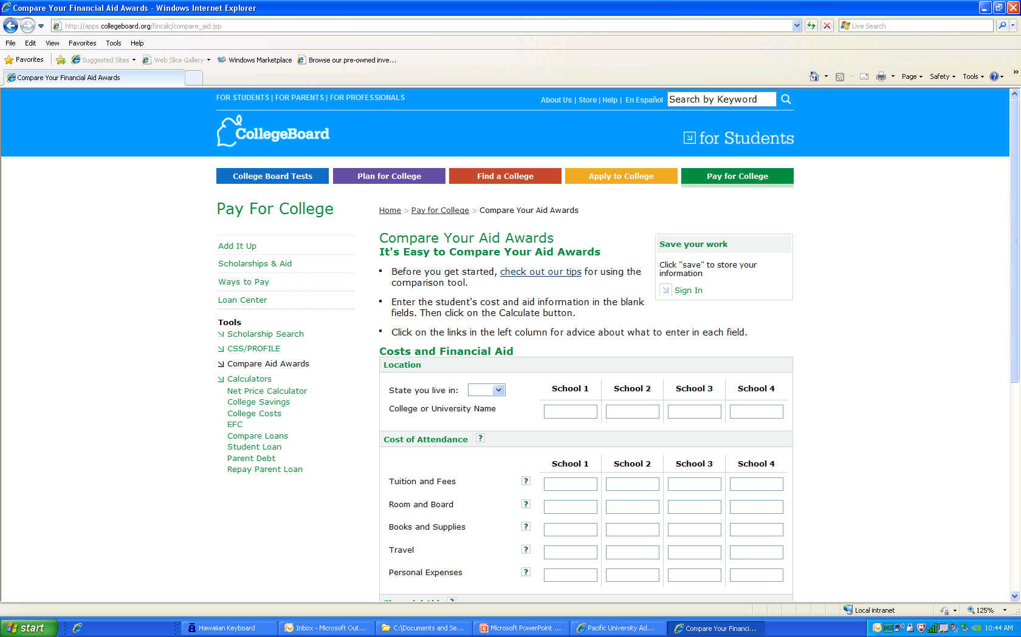
Notes:
Resource on College Board for students

Slide 14
INFORM COLLEGES OF YOUR DECISION…
Colleges require a tuition AND housing deposit to hold your space in class and dormitory
Make sure you send in your deposits by the deadline (online or by mail)!
Notify colleges that you are rejecting their offer of admission to enable them to offer your space to another student.

Slide 15
MAY 1ST IS NATIONAL CANDIDATES’ REPLY DATE
COMMITMENT AND DEPOSIT REQUIRED.
DO NOT COMMIT TO MORE THAN ONE SCHOOL.
YOU MAY ASK A COLLEGE FOR A DEADLINE EXTENSION.

Slide 16
WHAT TO DO AFTER CHOOSING A COLLEGE…
Read All College Materials Carefully
  Information on orientation, financial aid, housing, meal plans, etc.
Send the Tuition Deposit
  Reserves your place in the freshman class
  Look for the reply date in your packet
  National Candidates Reply Date is May 1st

Slide 17
WHAT TO DO AFTER CHOOSING A COLLEGE…
Accept the Financial Aid Offer
  You are not required to accept the entire aid package as is
  Decide how much of the offer to accept
  Complete, sign and return form by the deadline
  Being late can cost you serious money

Slide 18
WHAT TO DO AFTER CHOOSING A COLLEGE…
Send the Housing Deposit
  Review housing information packet
  Complete housing application and roommate questionnaire (paper or online)
  Select a Meal Plan
  Reserves your space in a dorm
  Be aware of the deadline!

Slide 19
Students who are “waitlisted” at
1st choice colleges…
Call or write to the college immediately
  Tell them that they are your first choice college, and if accepted, you will attend
Ask your counselor to send the college any new supporting information- 3rd quarter grades, most recent test scores, awards and honors received recently

Slide 20
IF YOU WERE NOT ACCEPTED TO THE COLLEGE OF YOUR CHOICE…
You still have some options open
Talk to your parent/counselor about options
Remember, it is possible to enroll in a college for a year or two, and then transfer
Community College, Military, Job

Slide 21
REMINDERS
Complete Counseling Graduation Requirements
  Take one SAT or ACT
  Resume
  Apply to one college
For males, register with Selective Service

Slide 22
FINISH STRONG
Ekalesia / P. E. Fitness
Survey
Fight Senioritis
Continue to do your best academically
Support each other and continue to make good decisions
Imua Class of 2013!

Slide 23
- Food for your Thoughts -
The ultimate quality of your life, and your happiness, is determined by your courageous and ethical choices, and your overall attitude.

